Slide 1

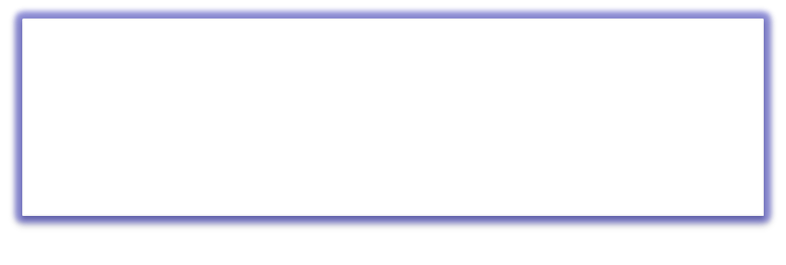

QUEUE
Free Powerpoint Templates

Slide 2
Queue
  Ordered collection of homogeneous elements
  Non-primitive linear data structure.
  A new element is added at one end called rear end and the existing elements are deleted from the other end called front end.
  This mechanism is called First-In-First-Out (FIFO).
e.g. People standing in Queue for Movie Ticket

Slide 3
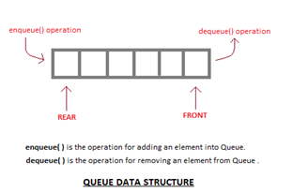
Fig: Model of a Queue

Slide 4
Queue as ADT(abstract data type.)
Queue is a data structure which allows a programmer to insert an element at one end known as “Rear” and to delete an element at other end known as “Front”.
Queue is an abstract data type because it not only allows storing elements but also allows to perform certain operation on these elements.

Slide 5
Queue as ADT(abstract data type.)
These operations are as follows.
  Initialize()
  enqueue()
  dequeue()
  Isempty()
  Isfull()
  Display()
Elements of queue:-
  Front
  Rear
  array

Slide 6
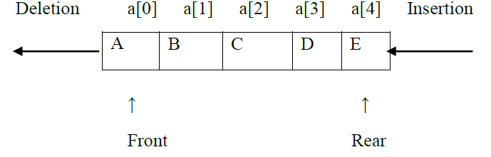
Elements of queue:-
Front: -
  This end is used for deleting an element from a queue. Initially front end is set to -1. Front end is incremented by one when a new element has to be deleted from queue.
  Rear: -
  This end is used for inserting an element in a queue. Initially rear end is set to -1. rear end is incremented by one when a new element has to be inserted in queue.

Slide 7
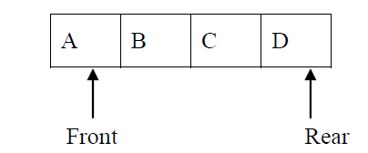
‘Queue Full(Overflow)’ Condition
Queue Full(Overflow):
  Inserting an element in a queue which is already full is known as Queue Full condition (Rear = Max-1).
  When the queue is fully occupied and enqueue() operation is called queue overflow occurs.
Example: Queue Full:
  Before inserting an element in queue 1st check whether space is available for new element in queue. This can be done by checking position of rear end. Array begins with 0_{th} index position & ends with max-1 position. If numbers of elements in queue are equal to size of queue i.e. if rear end position is equal to max-1 then queue is said to be full. Size of queue = 4

Slide 8

‘Queue Empty(Underflow)’ Condition
Queue Empty:
  Deleting an element from queue which is already empty is known as Queue Empty condition (Front = Rear = -1)
  When the queue is fully empty and dequeue() operation is called queue underflow occurs.
Queue Empty:
  Before deleting any element from queue check whether there is an element in the queue. If no element is present inside a queue & front & rear is set to -1 then queue is said to be empty.
  Size of queue = 4
  Front = Rear = -1

Slide 9
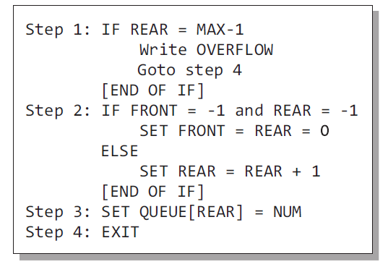
Algorithm to insert element
(enqueue Operation)

Slide 10
Algorithm to insert element
(enqueue Operation)
In Step 1, we first check for the overflow condition
In Step 2, we check if the queue is empty
  In case the queue is empty, then both FRONT and REAR are set to zero so that the new value can be stored at the 0th location
  Otherwise, if the queue already has some values, then REAR is incremented so that it points to the next location in the array
In Step 3, the value is stored in the queue at the location pointed by REAR

Slide 11
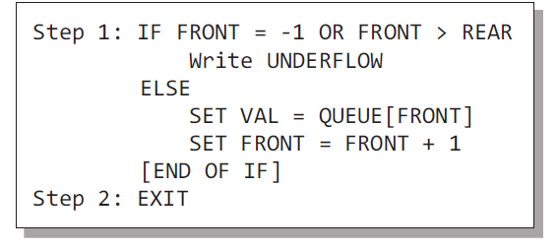
Algorithm to delete element
(dequeue Operation)
In Step 1, we check for underflow condition. An underflow occurs if FRONT = –1 or FRONT > REAR
However, if queue has some values, then FRONT is incremented so that it now points to the next value in the queue

Slide 12
Front=-1
Queue is empty
Front=1
Delete
1
5
B
C
0
1
2
3
4
0
1
2
3
4
Rear=-1
Rear=2
Front=0
Insert A
Front=2
Delete
2
A
6
C
0
1
2
3
4
0
1
2
3
4
Rear=0
Rear=2
Front=0
Insert B
Front=3
Delete
3
A
B
7
0
1
2
3
4
0
1
2
3
4
Rear=1
Rear=2
Queue is empty
Front=0
Insert C
Entry point is called Rear &
Exit point is called Front
4
A
B
C
0
1
2
3
4
Rear=2

Slide 13
Disadvantages of linear queue
On deletion of an element from existing queue, front pointer is shifted to next position.
This results into virtual deletion of an element.
By doing so memory space which was occupied by deleted element is wasted and hence inefficient memory utilization is occur.

Slide 14
Overcome disadvantage of linear queue:
To overcome the disadvantage of linear queue, the circular queue is used
We can solve this problem by joining the front and rear end of a queue to make the queue as a circular queue
A circular queue is a linear data structure. It follows the FIFO principle
In a circular queue, the last node is connected back to the first node to make a circle

Slide 15
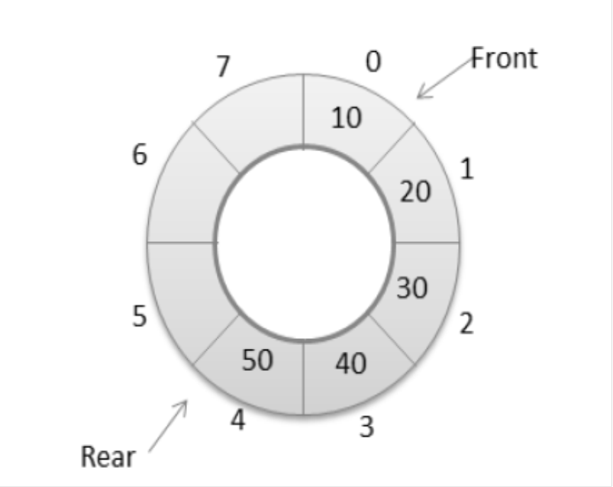
Overcome disadvantage of linear queue:
It is also called as “Ring buffer”.
Items can inserted and deleted from a queue in O(1) time.

Slide 16

Representation Of Queues
1.Using an array
2.Using linked list

Slide 17
Types Of Queue
1. Circular Queue
2. Dequeue (Double Ended Queue)

Slide 18

CIRCULAR QUEUE
FRONT = 0 and REAR = 9
If you want to insert another value, it will not be possible because the queue is completely full. There is no empty space where the value can be inserted

Slide 19

CIRCULAR QUEUE
Front = 2 and REAR = 9
Consider a scenario in which two successive deletions are made
Suppose we want to insert a new element in the queue
Even though there is space available, the overflow condition still exists because the condition rear = MAX – 1 still holds true
This is a major drawback of a linear queue

Slide 20
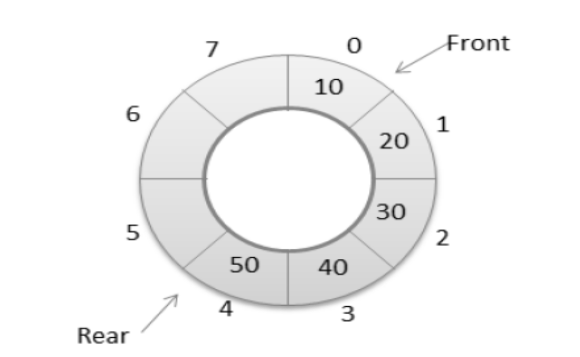
CIRCULAR QUEUE
To resolve this problem, we have two solutions
First, shift the elements to the left so that the vacant space can be occupied and utilized efficiently
But this can be very time-consuming, especially when the queue is quite large
The second option is to use a circular queue
In the circular queue, the first index comes right after the last index

Slide 21
CIRCULAR QUEUE
A queue is called a circular queue in which the last node is connected back to the first node to form a cycle
Circular queues are queues implemented in circular form rather than straight lines
Circular queues overcome the problem of unutilized space in linear queues implemented as an array
The main disadvantage of linear queue using an array is that when elements are deleted from the queue, new elements cannot be added in their place in the queue, i.e. the position cannot be reused

Slide 22
CIRCULAR QUEUE IMPLEMENTATION
After the rear reaches the last position, i.e. MAX-1 in order to reuse the vacant positions, we can bring rear back to the 0th position, if it is empty, and continue incrementing the rear in the same manner as earlier
Thus rear will have to be incremented circularly
For deletion, the front will also have to be incremented circularly

Slide 23

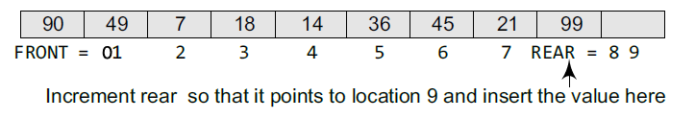
Enqueue(Insert) operation on
Circular Queue:
A circular queue is implemented in the same manner as a linear queue is implemented
For insertion, we now have to check for the following three conditions:
  If front = 0 and rear = MAX – 1, then the circular queue is full
2. If rear != MAX – 1, then rear will be incremented and the value will be inserted

Slide 24
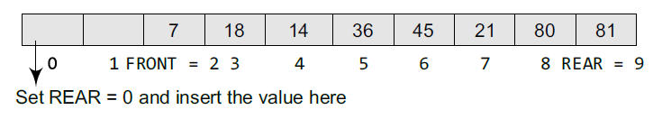
Enqueue(Insert) operation on
Circular Queue:
  3. If front != 0 and rear = MAX – 1, then it means that the queue is not full. So, set rear = 0 and insert the new element there

Slide 25
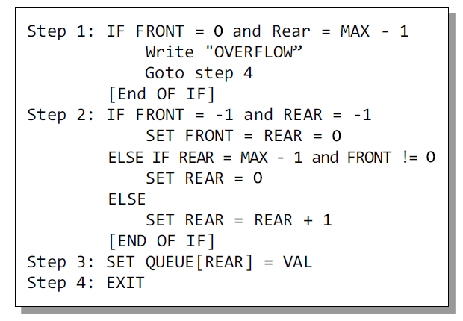
Enqueue(Insert) operation on
Circular Queue:

Slide 26
Enqueue(Insert) operation on
Circular Queue:
In Step 1, we check for the overflow condition
In Step 2, we make two checks.
  First to see if the queue is empty
  Second to see if the REAR end has already reached the maximum capacity while there are certain free locations before the FRONT end
In Step 3, the value is stored in the queue at the location pointed by REAR

Slide 27

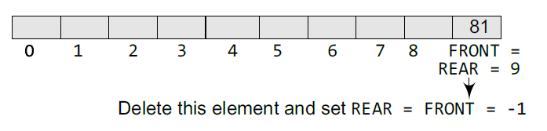
Dequeue (Delete) operation on
Circular Queue:
If front = –1, then there are no elements in the queue. So, an underflow condition will be reported
If the queue is not empty and front = rear, then after deleting the element at the front the queue becomes empty and so front and rear are set to –1

Slide 28
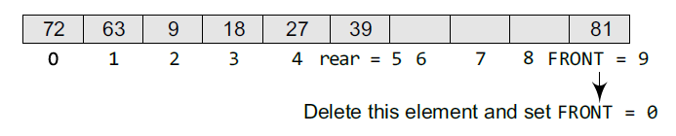
Dequeue (Delete) operation on
Circular Queue:
If the queue is not empty and front = MAX–1, then after deleting the element at the front, front is set to 0

Slide 29
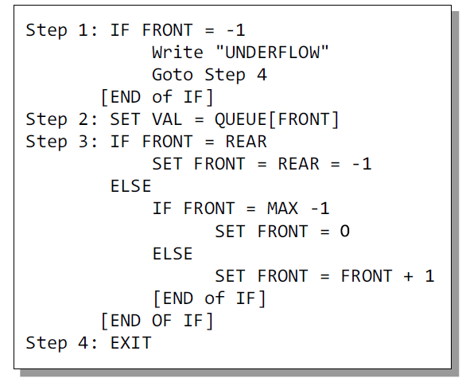
Dequeue (Delete) operation on
Circular Queue:

Slide 30
Dequeue (Delete) operation on
Circular Queue:
In Step 1, we check for the underflow condition
In Step 2, the value of the queue at the location pointed by FRONT is stored in VAL
In Step 3, we make two checks.
  First to see if the queue has become empty after deletion
  Second to see if FRONT has reached the maximum capacity of the queue
The value of FRONT is then updated based on the outcome of these checks

Slide 31
Double Ended queue (deQue)
A deque (pronounced as ‘deck’ or ‘dequeue’) is a list in which the elements can be inserted or deleted at either end
It is also known as a head-tail linked list because elements can be added to or removed from either the front (head) or the back (tail) end
However, no element can be added and deleted from the middle

Slide 32
Double Ended queue (deQue)
In the computer’s memory, a deque is implemented using either a circular array or a circular doubly linked list
In a deque, two pointers are maintained, LEFT and RIGHT, which point to either end of the deque
The elements in a deque extend from the LEFT end to the RIGHT end and since it is circular, Dequeue[N–1] is followed by Dequeue[0]

Slide 33
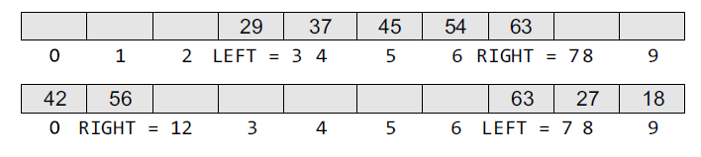
Double Ended queue (deQue)
There are two variants of a double-ended queue
Input restricted deque- In this dequeue, insertions can be done only at one of the ends, while deletions can be done from both ends
Output restricted deque- In this dequeue, deletions can be done only at one of the ends, while insertions can be done on both ends

Slide 34
Applications of Queue
  Serving requests on a single shared resource, like a printer, CPU task scheduling, etc
  In real life, Call Center phone systems will use Queues, to hold people calling them in an order, until a service representative is free

